Slide 1

Lead scoring Case Study
Arockia l.
Anuradha k.

Slide 2
Problem statement
An education company named X Education sells online courses to industry professionals. On any given day, many professionals who are interested in the courses land on their website and browse for courses.
The company get leads through different online and offline sources. The typical lead conversion rate at X education is around 30%.
The company wishes to identify the most potential leads, also known as ‘Hot Leads’. If they successfully identify this set of leads, the lead conversion rate should go up as the sales team will now be focusing more on communicating with the potential leads rather than making calls to everyone.
The company requires us to build a model wherein we need to assign a lead score to each of the leads such that the customers with higher lead score have a higher conversion chance and the customers with lower lead score have a lower conversion chance.
The CEO, in particular, has given a ballpark of the target lead conversion rate to be around 80%.

Slide 3
Objectives of the projective
Build a logistic regression model to assign a lead score between 0 and 100 to each of the leads which can be used by the company to target potential leads. A higher score would mean that the lead is hot, i.e. is most likely to convert whereas a lower score would mean that the lead is cold and will mostly not get converted.
There are some more problems presented by the company which your model should be able to adjust to if the company's requirement changes in the future so you will need to handle these as well. These problems are provided in a separate doc file. Please fill it based on the logistic regression model you got in the first step. Also, make sure you include this in your final PPT where you'll make recommendations.

Slide 4
Steps
Read, understand and prepare the data.
Analysis of missing values and/or inaccurate values
Understanding the variables one by one and making any changes as needed
Exploratory Data Analysis
Understanding each column since the no of variables are relatively less and each one has an impact on lead conversion
Making changes in in accurate columns
Outlier Analysis / Transformation / Treatment
Conduct numeric variable analysis for outliers
Modelling
Train Test split, Feature selection and Training the model
Model accuracy & Metrics
Calculation of Sensitivity, Specificity, Negative and Positive prediction rates of our model
Final analysis and conclusions
Calculation of various metrices like accuracy, F1 score, precision recall etc., to draw conclusion from the model

Slide 5
Data available
We have been provided with data on the form filled by individuals who visited the website of X education
Data set has 9240 rows and 37 columns
The data set has 17 (out of 37) columns with missing values.
There are 7 numerical columns while rest are categorical
Three variables - How did you hear about X Education (78.46), Lead Profile (74.19), Lead Quality (51.59), have the highest percentage missing values

Slide 6
Data Preparation – Percentage Missing values per column
Variable
How did you hear about X Education | 78.46
Lead Profile | 74.19
Lead Quality | 51.59
Asymmetrique Profile Score | 45.65
Asymmetrique Activity Score | 45.65
Asymmetrique Profile Index | 45.65
Asymmetrique Activity Index | 45.65
City | 39.71
Specialization | 36.58
Tags | 36.29
What matters most to you in choosing a course | 29.32
What is your current occupation | 29.11
Country | 26.63
TotalVisits | 1.48
Page Views Per Visit | 1.48
Last Activity | 1.11
Lead Source | 0.39
Lead Origin | 0.00
Lead Number | 0.00
Do Not Email | 0.00
Do Not Call | 0.00
Converted | 0.00
Total Time Spent on Website | 0.00
Last Notable Activity | 0.00
Newspaper Article | 0.00
Search | 0.00
Magazine | 0.00
A free copy of Mastering The Interview | 0.00
X Education Forums | 0.00
Newspaper | 0.00
Digital Advertisement | 0.00
Through Recommendations | 0.00
Receive More Updates About Our Courses | 0.00
Update me on Supply Chain Content | 0.00
Get updates on DM Content | 0.00
I agree to pay the amount through cheque | 0.00
Prospect ID | 0.00

Slide 7
Data Preparation – missing values imputed by physical examination of each variable
Among the three columns with greater than 50 percent missing values two seem to have high business relevance “Lead Profile” will help in better targeting, “Lead Quality” is based on the employee intuition and helps us to realise the ‘hotness’ of a lead.
Hence, all categorical columns have to be individually analyzed and imputed or deleted after careful observation. Except “The source of the leads has 36 missing values which is 0.4% of total values.” Hence these rows can be ignored
There are no duplicate entries for lead number and prospect ID. i.e. all are unique
There are five categorical column (mentioned below) with only one unique value. During dummy variable creation step these column will not be much significant as all encoded numerical value will be same and will be of no use to the model
Get updates on DM Content
I agree to pay the amount through cheque
Receive More Updates About Our Courses
Magazine
Update me on Supply Chain Content
All numerical variables will be standardized after the train test split
In some columns the value "Select" contributes to most of the entries which can due to missing values or information is not filled. All select value from entire data set can be considered to Null or blank

Slide 8
EDA and Data transformation
We conduct an EDA for each of the variable and do the following
Understand the conversion rate for each of the inputs of the variables to select the most relevant variables
Consider the input ‘Select’ as a blank
Impute inputs with very small ‘value counts’ as others.
Rename the inputs for if there are any spelling errors
Dropping outliers wherever applicable
Few examples of data conversion are below
Variables - 'Search’ 'Do Not Email', 'Do Not Call', 'Newspaper Article', 'X Education Forums', 'Newspaper’, 'Digital Advertisement’, 'Through Recommendations’ 'A free copy of Mastering The Interview’, are converted to binary variables
Variables - 'Country’ 'Lead Source’ 'Lead Origin’ 'Last Notable Activity’ are converted to dummies.

Slide 9

Model formation
We train the model on 70 percent of the data and test the model on rest of the 30 percent
We take the ‘converted’ variables as our DEPENDENT VARIABLE
We standardize the numeric variables using StandardScaler
We remove features of low predictive value using recursive feature elimination
The logistic regression model was built in Python using the function GLM(Generalized Linear Model) under statsmodel library. RFE was coupled with manual approach based on the VIFs and p-values.

Slide 10
Model Findings - Summary
Generalized Linear Model Regression Results
Dep. Variable: | Converted | No. Observations: | 6050
Model: | GLM | Df Residuals: | 6030
Model Family: | Binomial | Df Model: | 19
Link Function: | logit | Scale: | 1
Method: | IRLS | Log-Likelihood: | -1165.1
Date: | Sun, 25 Aug 2019 | Deviance: | 2330.3
Time: | 18:23:48 | Pearson chi2: | 10200.00
No. Iterations: | 8 | Covariance Type: | nonrobust
 | coef | std err | z | P>|z| | [0.025 | 0.975]
const | -2.1087 | 0.101 | -20.886 | 0.000 | -2.31 | -1.91
Lead Source_Welingak Website | 4.0712 | 1.028 | 3.961 | 0.000 | 2.057 | 6.086
Last Notable Activity_Modified | -1.5189 | 0.13 | -11.662 | 0.000 | -1.77 | -1.26
Last Activity_SMS Sent | 2.1357 | 0.122 | 17.479 | 0.000 | 1.896 | 2.375
What is your current occupation_Student | 2.187 | 0.526 | 4.161 | 0.000 | 1.157 | 3.217
What is your current occupation_Unemployed | 2.2048 | 0.132 | 16.727 | 0.000 | 1.946 | 2.463
What is your current occupation_Working Professional | 2.5384 | 0.388 | 6.538 | 0.000 | 1.777 | 3.299
Tags_Already a student | -3.6297 | 0.609 | -5.96 | 0.000 | -4.82 | -2.44
Tags_Closed by Horizzon | 5.7858 | 0.731 | 7.916 | 0.000 | 4.353 | 7.218
Tags_Interested in full time MBA | -2.8505 | 0.737 | -3.869 | 0.000 | -4.29 | -1.41
Tags_Interested in other courses | -2.9039 | 0.369 | -7.868 | 0.000 | -3.63 | -2.18
Tags_Lost to EINS | 5.6409 | 0.579 | 9.74 | 0.000 | 4.506 | 6.776
Tags_Not doing further education | -3.7545 | 1.035 | -3.627 | 0.000 | -5.78 | -1.73
Tags_Other_Tags | -2.0184 | 0.304 | -6.64 | 0.000 | -2.61 | -1.42
Tags_Ringing | -4.829 | 0.263 | -18.363 | 0.000 | -5.34 | -4.31
Tags_Will revert after reading the email | 3.4095 | 0.217 | 15.725 | 0.000 | 2.985 | 3.834
Tags_invalid number | -4.694 | 1.04 | -4.512 | 0.000 | -6.73 | -2.66
Tags_switched off | -5.5891 | 0.73 | -7.661 | 0.000 | -7.02 | -4.16
Lead Quality_Worst | -1.7463 | 0.638 | -2.735 | 0.006 | -3 | -0.5
Asymmetrique Activity Index_Low | -2.2103 | 0.418 | -5.283 | 0.000 | -3.03 | -1.39

Slide 11
Model Findings - Summary
Features | VIF
Tags_Closed by Horizzon | 1.44
Tags_Other_Tags | 1.43
What is your current occupation_Student | 1.32
Tags_Not doing further education | 1.31
Tags_switched off | 1.23
Tags_Interested in full time MBA | 1.17
Asymmetrique Activity Index_Low | 1.15
Tags_Lost to EINS | 1.12
Lead Source_Welingak Website | 1.10
Tags_invalid number | 1.09
What is your current occupation_Working Professional | 0.97
Lead Quality_Worst | 0.70
Tags_Interested in other courses | 0.43
Tags_Already a student | 0.42
Last Activity_SMS Sent | 0.22
Last Notable Activity_Modified | 0.15
Tags_Will revert after reading the email | 0.10
What is your current occupation_Unemployed | 0.08
Tags_Ringing | 0.03

Slide 12
Model Conclusions
Insights:
The p- values for all variables in the final model is <0.05
All the features have VIF values < 3. Hence muliticollinearity hardly exist
The overall accuracy is 0.9315 at a probability threshold of 0.05 is also very acceptable

Slide 13
Metrics of the Model
Metric | Value (%) | Comments
Sensitivity | 92.8 | Indicates high true positive rate – the model predicts the no of leads that would convert accurately
Specificity | 93 | True negative rate. Identifies the non potential leads well
False Positive rate | 6.6 | Prevents non potentials leads from being identified as potential.
Positive predictive value | 89.5 | Identifies the positives in the case. Positive predictive value is the probability that subjects with a positive attributes truly have the potential to convert
Negative predictive value | 95.5 | Negative predictive value is the probability that subjects with a negative attributes truly are non potential

Slide 14
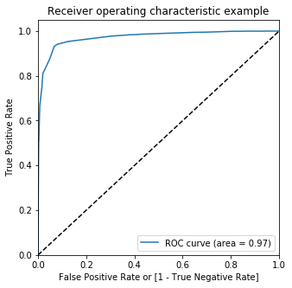
receiver operating characteristic curve
It shows the tradeoff between sensitivity and specificity (any increase in sensitivity will be accompanied by a decrease in specificity).
The closer the curve follows the left-hand border and then the top border of the ROC space, the more accurate the test.
The closer the curve comes to the 45-degree diagonal of the ROC space, the less accurate the test.
The area under our ROC is 0.972 (close to unity) shows that we have an accurate model

Slide 15
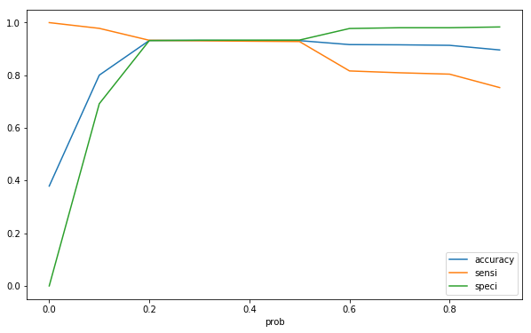
Optimal cut off probability - balanced sensitivity and specificity
Our test has a good diagnostic/predictive value

Slide 16
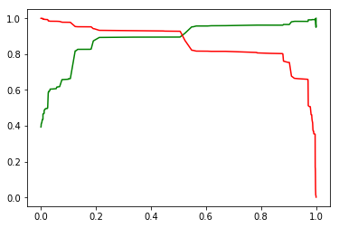
Other relevant metrics – accuracy, Precision and Recall
Accuracy (ACC) is calculated as the number of all correct predictions divided by the total number of the dataset. Accuracy of our model is high at 0.93.
Precision signifies the positive predictive value and high precision would mean low false positives. In our model precision is 89.5 percent. Precision can be thought of as a measure of a classifiers exactness.
Recall is the same as sensitivity. Our recall is 93 percent as discussed. Precision can be thought of as a measure of a classifiers completeness.
Business implications – In our case more false positives wouldn’t matter as false negatives, since that would mean that more potential leads remain excluded. Hence high recall is favorable.
Graph between precision and recall thresholds (precision is green)
Source - Classification Accuracy is Not Enough: More Performance Measures You Can Use by Jason Brownlee

Slide 17
Conclusion
AUC score of 0.967 indicate that the model performance is good on test dataset
Overall accuracy is 0.92 at a probability threshold of 0.3
Below features have a positive effect on conversion rate and hence need to kept in mind
Lead Source_Welingak Website
Last Activity_SMS Sent
What is your current occupation_Student
What is your current occupation_Unemployed
What is your current occupation_Working Professional
Tags_Closed by Horizzon
Tags_Lost to EINS
Tags_Will revert after reading the email

Slide 18
Conclusion
Below features have a negative effect on conversion rate
Last Notable Activity_Modified
Tags_Already a student
Tags_Interested in full time MBA
Tags_Interested in other courses
Tags_Not doing further education
Tags_Other_Tags
Tags_Ringing
Tags_invalid number
Tags_switched off
Lead Quality_Worst
Asymmetrique Activity Index_Low

Slide 19

Insights
Welingak website should be used for sourcing the leads
Text messages and emails should always be sent to the all the leads, whether hot or not. This increases chances of conversion.
Students (in other institutes), unemployed and working professionals are more likely to enroll
Horizzon should remain a trusted Learning Partner and also to provide leads. On the other hand EINS seems to be a competitor
While in case the student intends to do MBA or doesn’t answer his/her phone or has provided a wrong, is an existing student, keeps modifying his activity, or is interested in some other course, then may be he/she is just surfing the website and is not a serious candidate.

